Slide 1
Private Equity on the Blockchain
Team 3
Mostafa Joma
Devin Nigro
Pedro Nunes
Andrea Ovelar
Peter Repetto
Brody Wacker
Notes:
Andrea

Slide 2
Motivation
Generate a platform that can allow any investor the participation on Private Equity funds that tend to be illiquid and offered to a selected few. Funds will be raised through a crowdsale and then traded in the secondary market with a lock-in period of 10 years.
Notes:
Andrea

Slide 3
Project Overview
Private Equity funds can now raise funds through the creation of their own STO
Market creation after the funds are raise is generated for investors to sell and buy their coins in the fund
Fund strategy expected returns are generated using statistical techniques such as ARIMA, ARMA and LSTM
DAPP showing final findings
Notes:
ANDREA

Slide 4
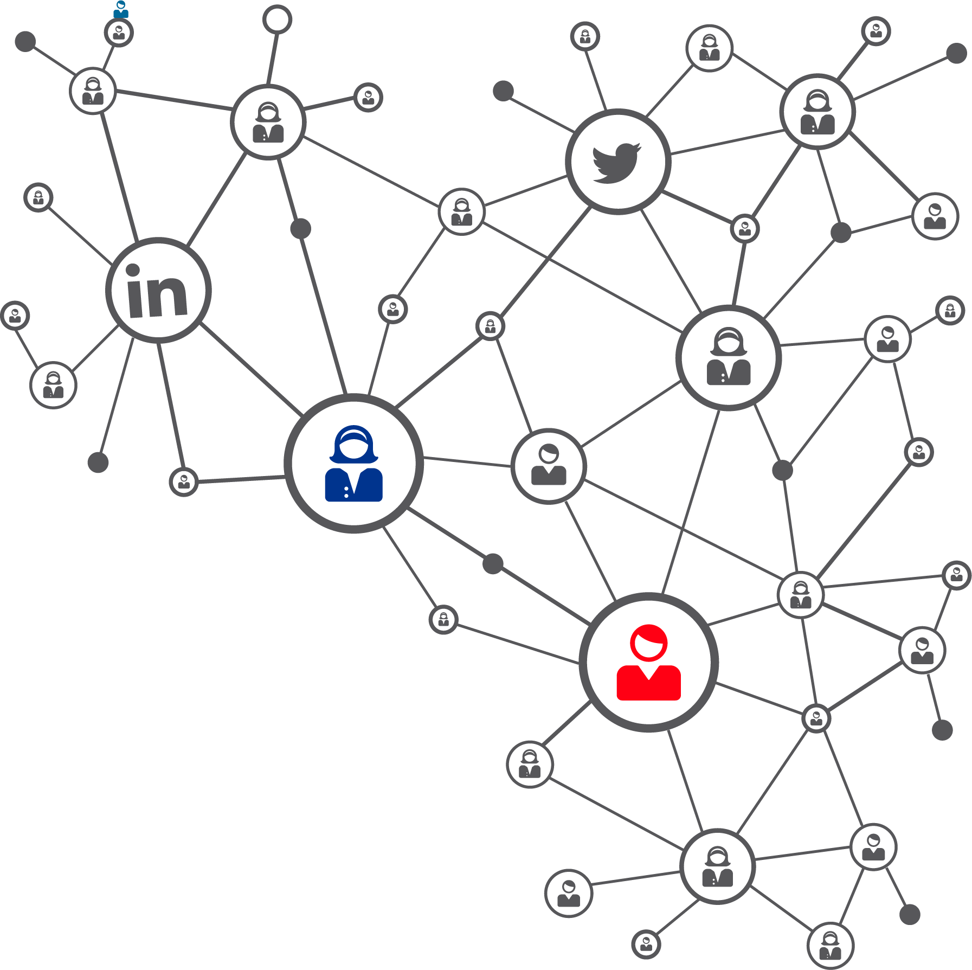

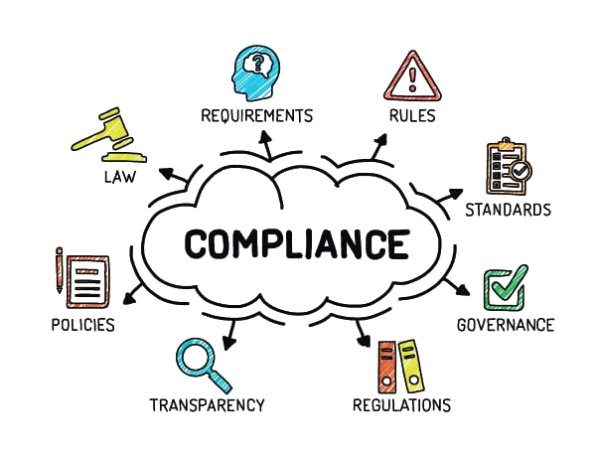
Tokenizing Private Equity Fund
Advantages
Access to Global Markets
Automated Servicing
ERC Compliance Enforcement
Ease of Asset Transferability
Notes:
MOSTAFA

Slide 5


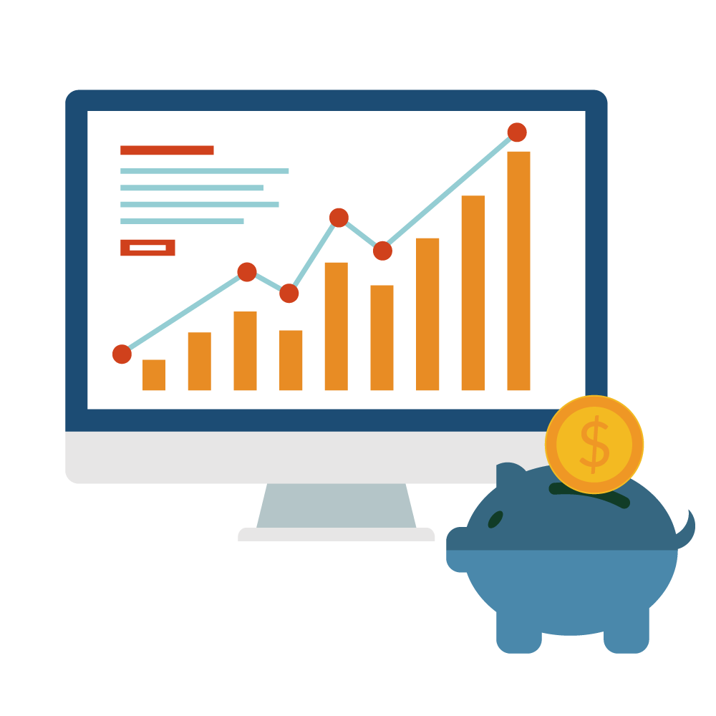
Tokenizing Private Equity Fund
Advantages will provide to investors:
Digital shares.
Greater liquidity
24/7 Market
Cost effective
Rapid settlement
Quickly assess positions
Notes:
MOSTAFA

Slide 6
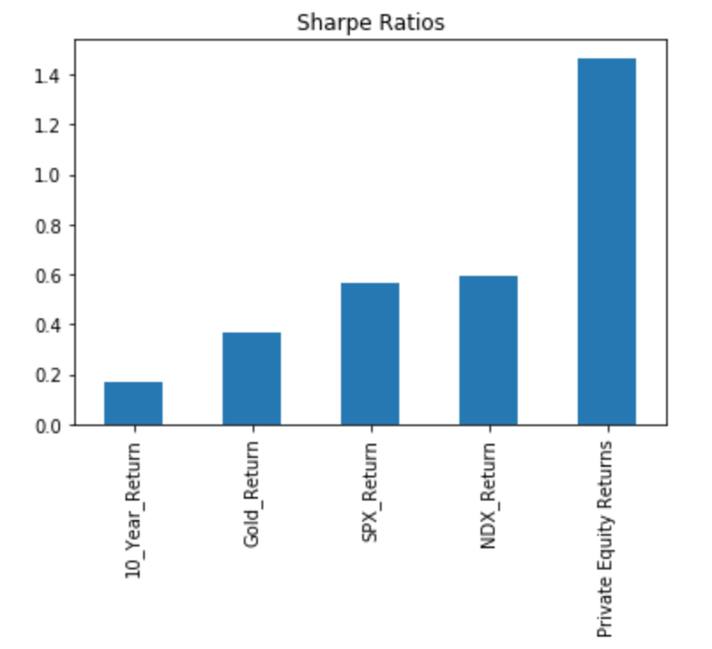
What Is The Differentiating factor?
Why Private Equity?
Based on historical analysis Private Equity Firms have been able to deliver higher returns with less volatility
Hence, Private Equity firms exhibit a higher sharpe ratio when compared to other global assets
Notes:
PETER

Slide 7
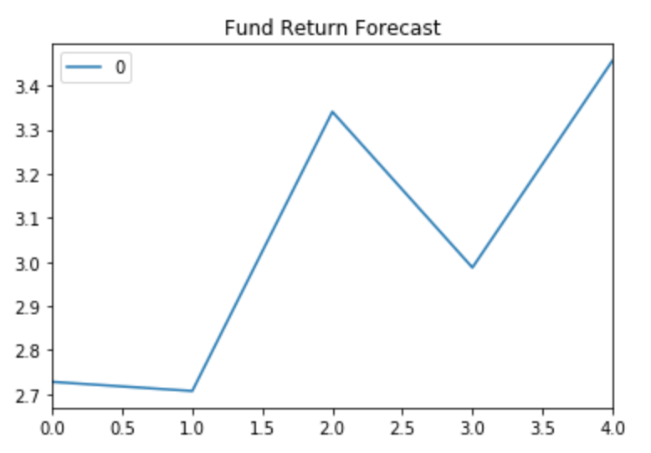
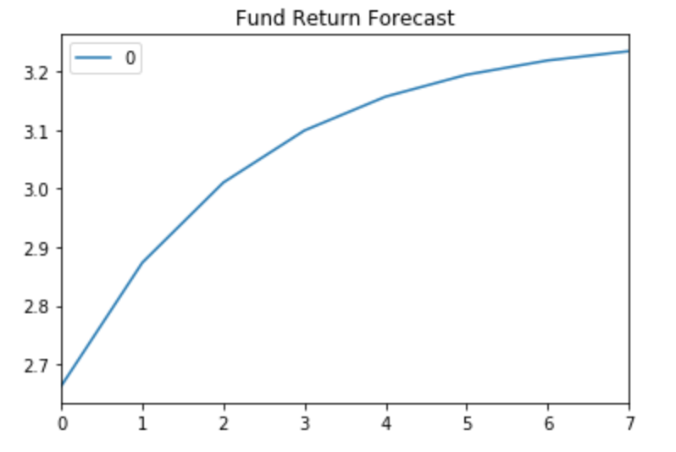
What Should Our Investors Expect?
A Good Night’s Sleep!
We went through a number of modelling efforts in order to help forecast the returns of our Fund
Through utilizing both an ARMA and ARIMA models, you can see returns for the fund are expected to be positive over the next 4-7 quarters
What if there is a second wave of COVID?? What if US -China Tensions continue to ramp up??
Past performance is not guarantee of future returns
Notes:
PETER

Slide 8
Deep Learning with LSTM RNN
Forecasting S&P 500 Returns with LSTM RNN model achieving a 0.0286 loss making for a competitive Forecasting tool for the fund to using when investing it’s capital. By using historical quarterly ending returns going back 33 years we are 99.9714% confident that the fund will correctly forecast S&P Returns.
Machine Learning at its Finest
Notes:
PEDRO

Slide 9
Conclusions
We were able to simulate a crowdsale for a Private Equity fund focusing on the broad S&P500 index.
We simulated expected returns using ARMA and ARIMA time series models that beat the Private Equity benchmark.
We simulated expected returns using LSTM RNN models achieving a 0.0286 loss score.
We were able to deploy a Decentralized APP where we can host the Dashboard to crowdsale tokens and fund investments to generate returns for investors.
Notes:
PEDRO

Slide 10

Thanks!
Mostafa Joma
Devin Nigro
Pedro Nunes
Andrea Ovelar
Peter Repetto
Brody Wacker

Slide 11
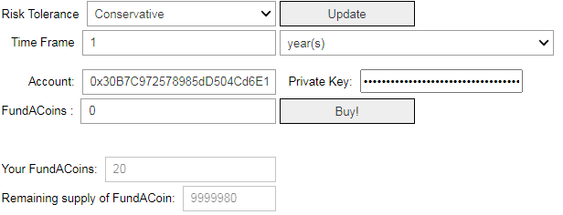


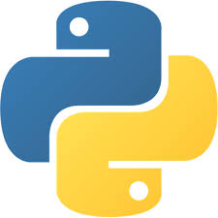


Appendix 1: Fundraising technologies (crowdsale)
Dashboard Example
Remix IDE (Solidity)
oppenzepellin
Python
Infura
Tested on Kovan network
Metamask
Exchange rate converter
Picture with Dashboard
Notes:
DEVIN

Slide 12
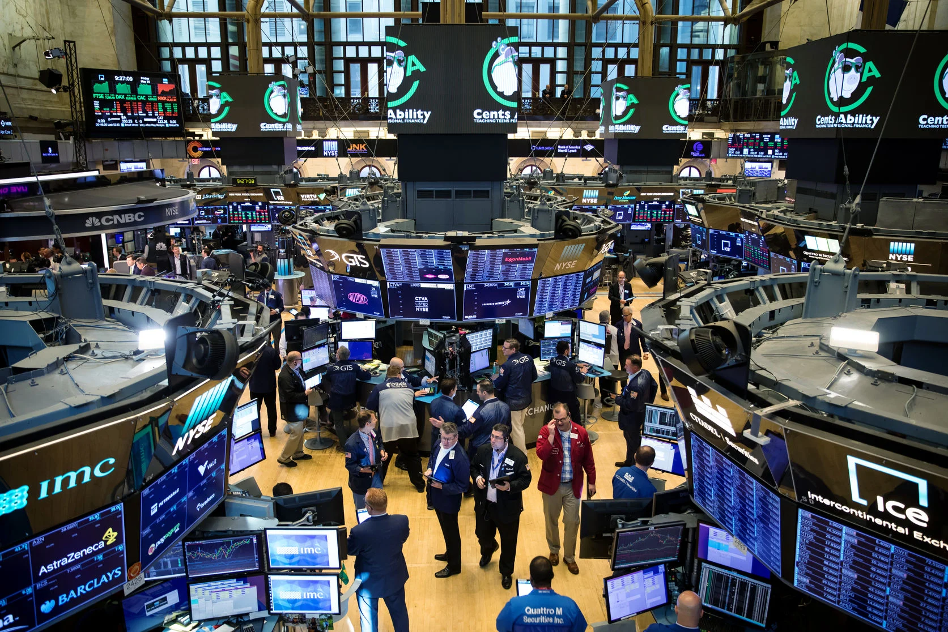
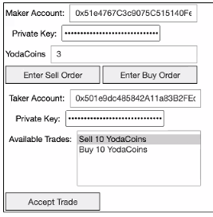

Appendix 2: Creating a market for the coins (Dashboard)
Notes:
BRODY

Slide 13
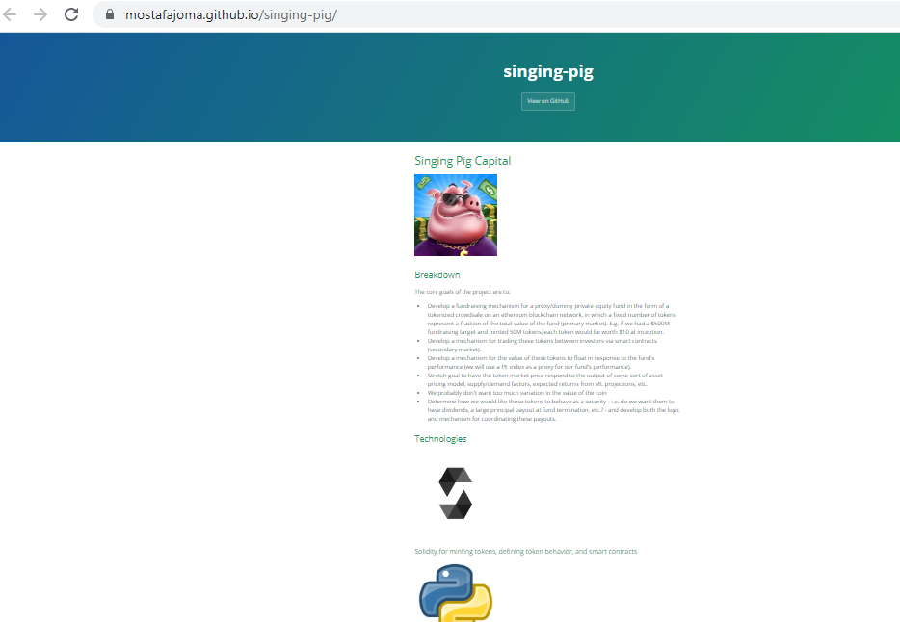
Appendix 3: Github to create a DAPP
Using a DAPP to commercialize the dashboard to a broader audience
Notes:
Mostafa

Slide 14
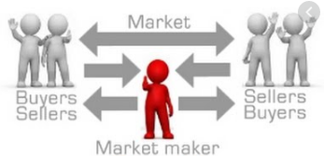

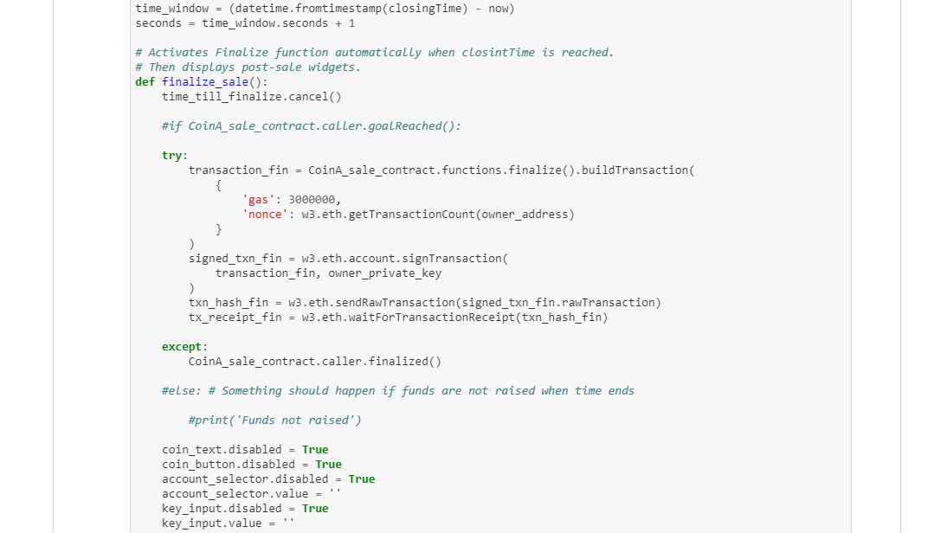
Appendix 4: Live demo (Buy&Sell)
Notes:
BRODY and DEVIN

